Slide 1
Lecture 17: Requirements modeling Ch 6
Punjab University College of Information Technology

Slide 2
Requirement analysis
Requirements analysis results in
  the specification of software’s operational characteristics
  Indicates software’s interface with other system elements
  Establishes constraints that software must meet

Slide 3
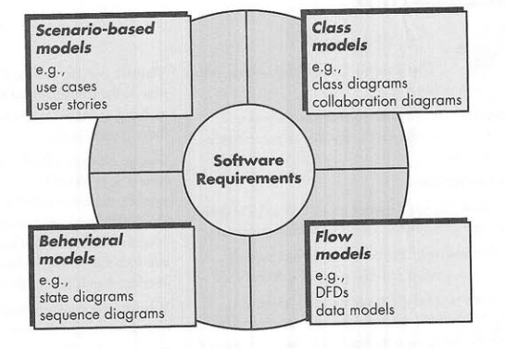
Requirement analysis

Slide 4
Requirement analysis
Requirements modeling results in one or more of the following types of models:
  Scenario-based models of requirements from the point of view of various system “actors”
  Data models that depict the information domain from the problem
  Class-oriented models that represent object-oriented classes and the manner in which classes collaborate to achieve system requirements

Slide 5
Requirement analysis
  Flow-oriented models that represent the functional elements of the system and how they transform data as it moves through the system
  Behavioral models that depict how the software behaves as a consequence of external “events”

Slide 6
Requirement analysis

Slide 7
Scenario-based Modeling
User satisfaction is the top priority, so understand how user interact with the system
Hence, requirements modeling with UML begins with the creation of scenario in the form of use cases, activity diagrams etc.

Slide 8
Scenario-based Modeling
User satisfaction is the top priority, so understand how user interact with the system
Hence, requirements modeling with UML begins with the creation of scenario in the form of use cases, activity diagrams etc.
Use case is characterize as a “contract of behavior”
Contract defines the way in which an actor uses a computer-based system to accomplish some goal

Slide 9
Scenario-based Modeling
Use case captures the interaction that occur between producers and consumers of information and the system itself
Use case describes usage scenario but
  What to write about it
  How much to write about it
  How detailed to make your description
  How to organize the description

Slide 10
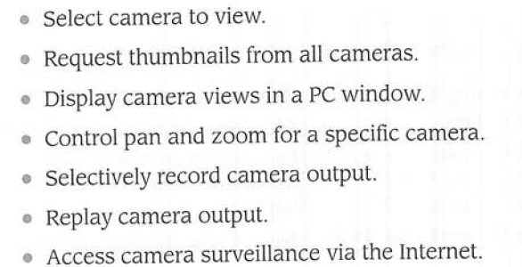
Scenario-based Modeling
Example safe house
Use case for each function

Slide 11
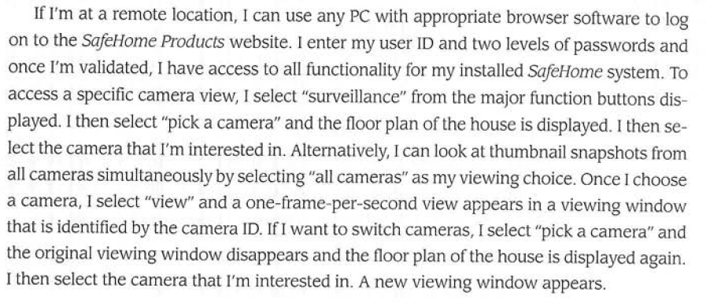
Scenario-based Modeling
Actor: homeowner
Narrative

Slide 12
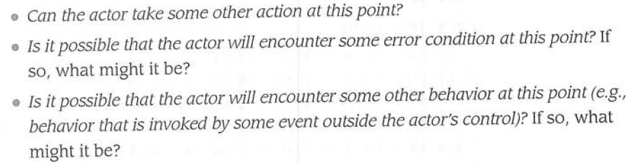
Scenario-based Modeling
Alternative flow

Slide 13
Use Case Modeling
Models the ‘actors’ outside a system and their interactions with that system
Every way that an ‘actor’ uses a system is called a Use Case
Model:
  Desired functionality
  Constraints on functionality
  Hence build what client wants!
Notes:
2

Slide 14
Reasons for Use Cases
No information system exists in isolation
Most systems interact with humans or other automated systems (actors) that use the system for some purpose
Actors expect the system to behave in a predictable way
Use Cases specify the behavior of the system
Helps visualize the system
Notes:
2

Slide 15
Use Case Modelling
Use Case diagram
  Diagram illustrating
    Actors
    Use cases in the system
Use Case Description
  Specification of what happens in each use case
    Textural description
    Diagrams

Slide 16
Example of a Use Case Diagram
Telephone catalogue
Check status
Salesperson
Place order
Customer
Fill orders
Shipping Clerk
Establish credit
Supervisor
Notes:
11

Slide 17
Elements of Use Case Models
Use Case
Actor
Relationship
Use Case Diagram
Scenario
System Boundary
Use case description
Notes:
6

Slide 18
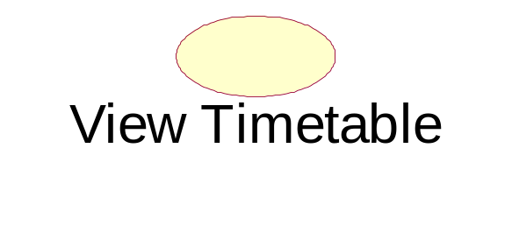
Use Case
A Use Case is an interaction between the system and a person or another system to achieve a result
A required “bit” of functionality
It yields an observable result of value to an actor (and hence a developer)
Typically named with a verb than a noun
  “Do something to something”
Notes:
6

Slide 19
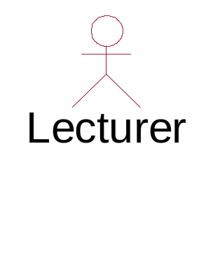
Actors
  A coherent set of roles that users of Use Cases play when interacting with Use Cases
  Roles not users or people
  User may have more than one role
Smith
Notes:
6

Slide 20
Relationships
A semantic connection among elements
Used to show:
  A function required by an actor
  Relationships between actors
  Relationships between use cases
Notes:
6

Slide 21
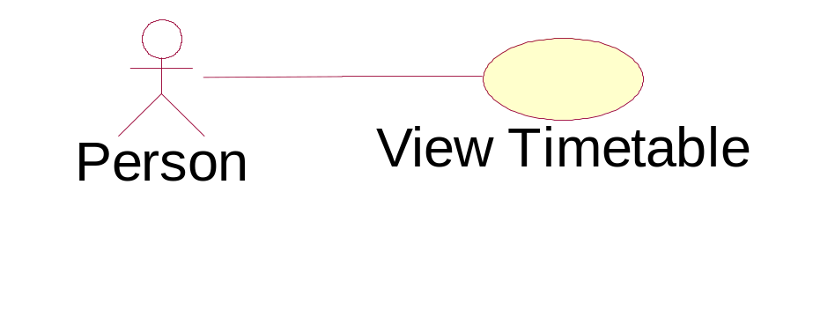
Use Case Diagram
A diagram that shows a set of Use Cases and Actors and their relationships
Use Case diagrams address a user-centric view of a system
Show a required “bit” of functionality
Notes:
6

Slide 22
Scenario / System Boundary
Scenario
  A single path through a Use Case
  Use case is usually a collection of scenarios
  Included as part of use case description
System Boundary
  A high level indication of the domain
  Limit to investigation
    System
    Part of system in focus
Notes:
6

Slide 23
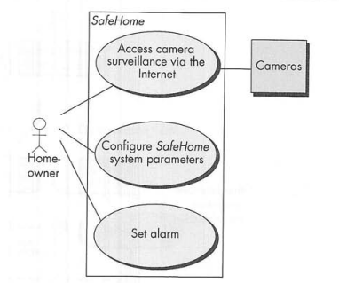
Scenario-based Modeling
Graphical representation of a use-case

Slide 24
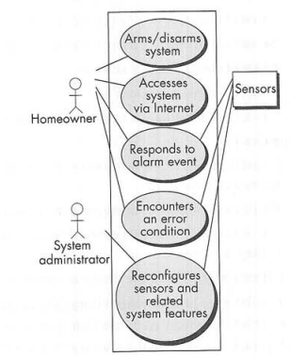
Scenario-based Modeling
Graphical representation of a use-case

Slide 25
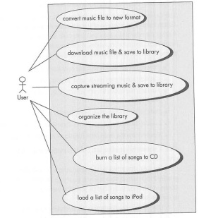
Scenario-based Modeling
Graphical representation of a use-case

Slide 26
Relationships in use cases
Between actor and use case
  Actor uses
Generalisation of actors
  Types of users
Use case stereotypes
  <<extend>>
    Optional
  <<include>>
    Mandatory
Stereotype is a UML extension mechanism to indicate a type of behaviour

Slide 27
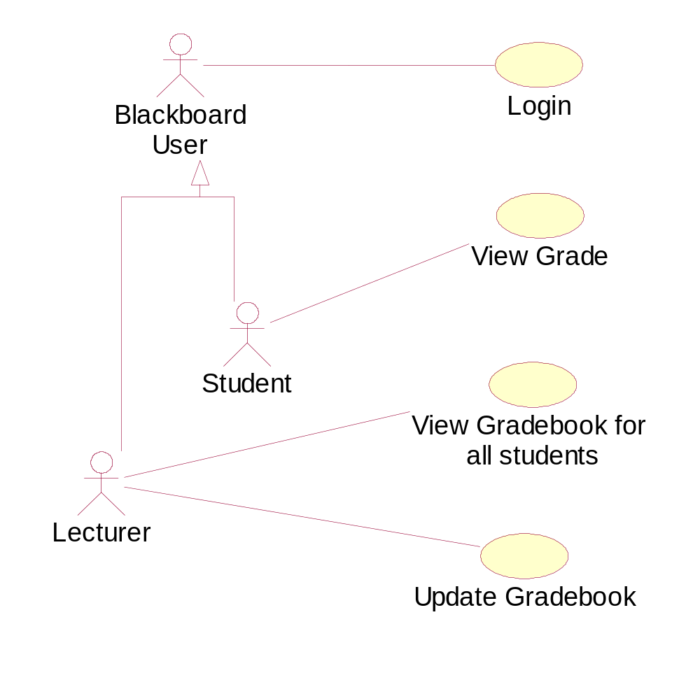
Generalisation of Actors
Blackboard Gradebook

Slide 28
Use case variants : include and extend
include relationship occurs when you have a chunk of behavior that is similar across more than one Use Case
  use in two or more separate Use Cases to avoid repetition
  a significant part of a use case
  <<include>>
extend relationship where you have one Use Case which adds functionality to another Use Case
  any Use Case can have more than one extend
  use when describing a variation on or in addition to normal behavior
  OPTIONAL BEHAVIOUR
    Otherwise part of use case or
    <<include>>
  <<extend>>
Notes:
13

Slide 29
Example of Use Case Variants
additional
functionality
Place order
<<extend>>
Open account
Extension Point
Place back order
Place back order
<<include>>
<<include>>
<<include>>
Supply
Customer Data
Arrange delivery
shared functionality
Notes:
14

Slide 30
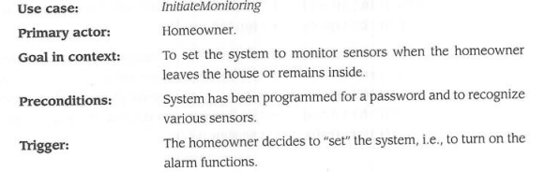
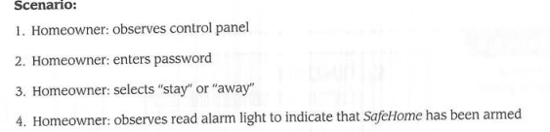
Scenario-based Modeling
Writing a formal use-case

Slide 31
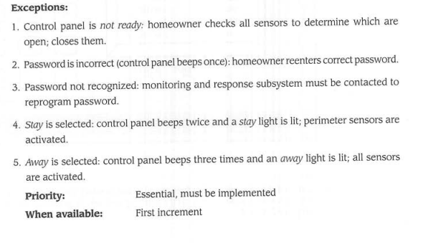
Scenario-based Modeling
Writing a formal use-case

Slide 32
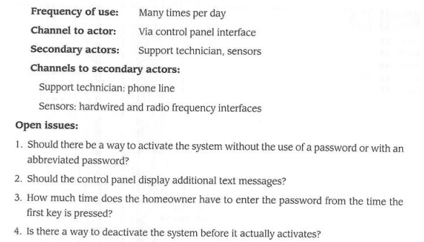
Scenario-based Modeling
Writing a formal use-case

